Slide 1
Topic: Subtracting Fractions
EQ: How do we subtract fractions?
Ms. Latham

Slide 2
Topic: Subtracting Fractions
EQ: How do I subtract fractions?
Subtracting fractions is very similar to adding fractions. We use the same methods to make the denominators the same and then subtract the numerators.
Subtracting with same denominator
Subtract the numerators

Slide 3
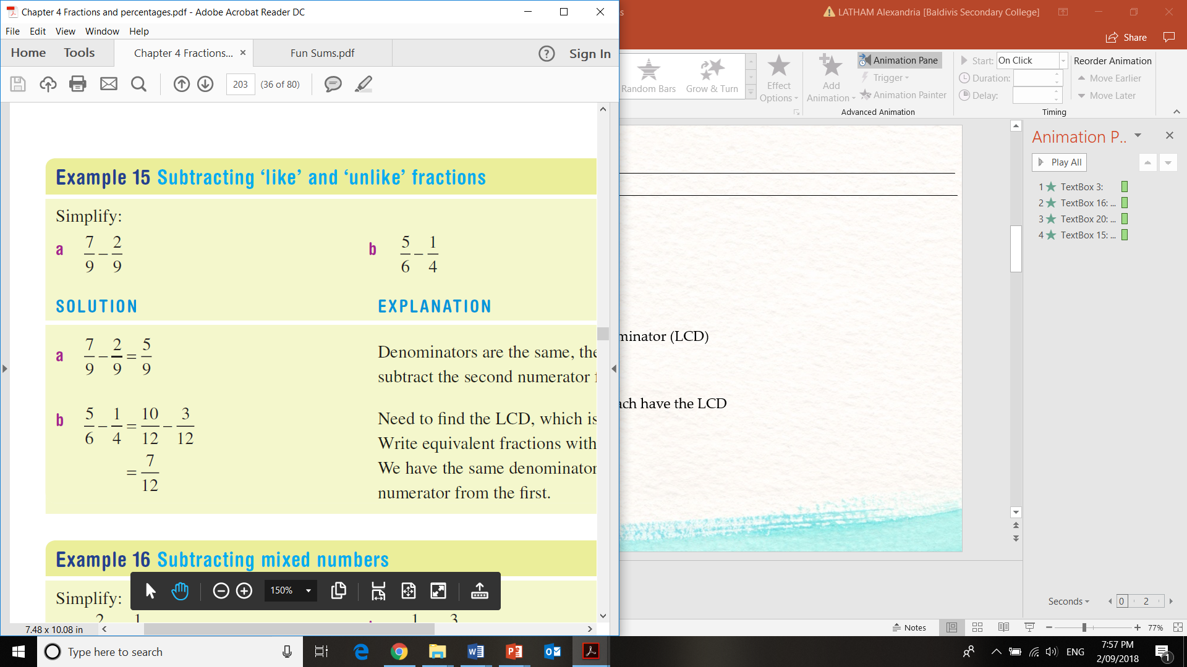
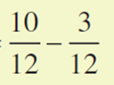
Topic: Subtracting Fractions
EQ: How do I subtract fractions?
Subtracting with same denominator
Subtract the numerators
Step 1: Find the Lowest Common Denominator (LCD)
Find the LCD
12
Step 2: Multiply the fractions so they each have the LCD
Step 3: Subtract the numerators

Slide 4
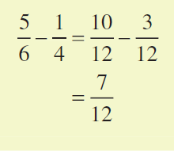
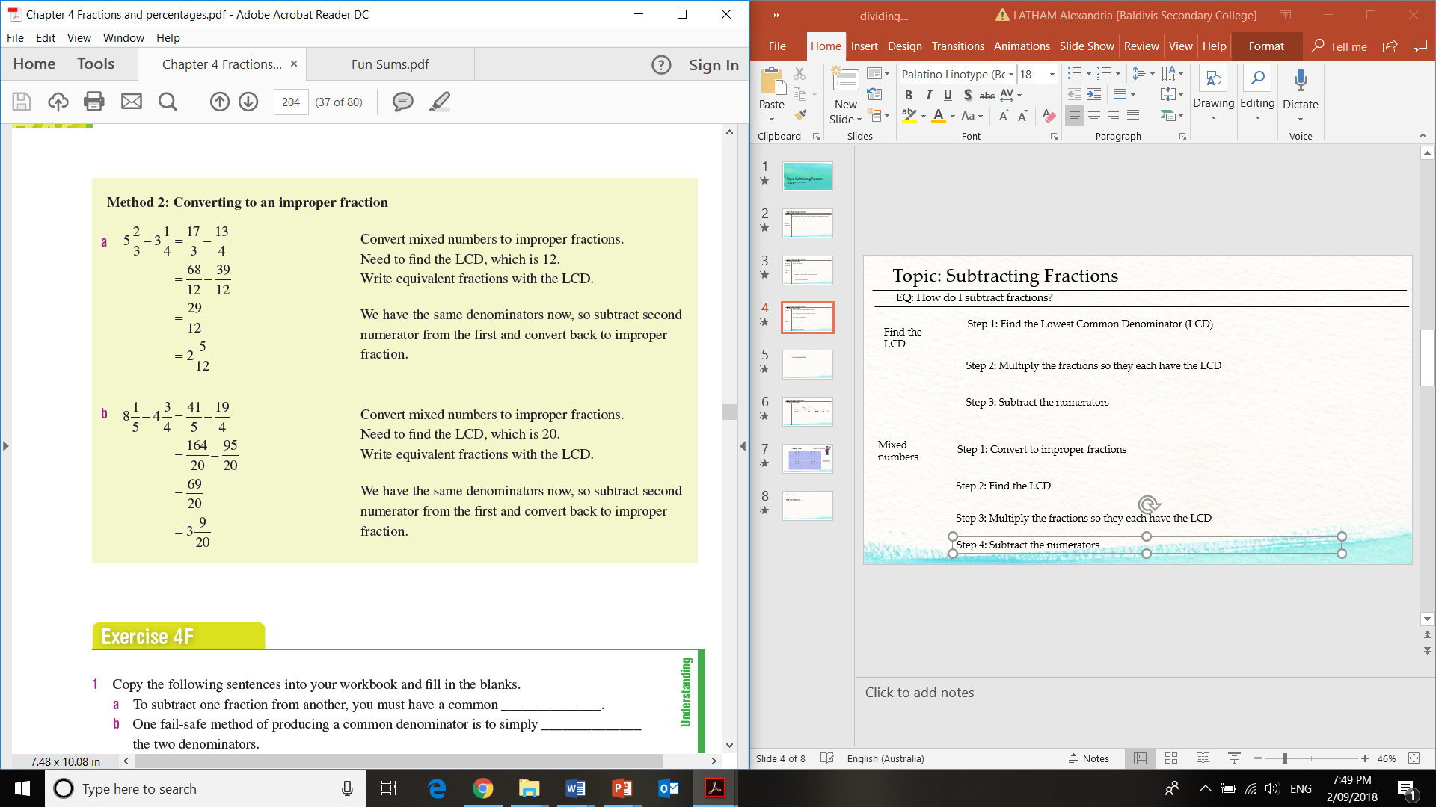
Topic: Subtracting Fractions
EQ: How do I subtract fractions?
Step 1: Find the Lowest Common Denominator (LCD)
Find the LCD
Step 2: Multiply the fractions so they each have the LCD
Step 3: Subtract the numerators
Step 1: Convert to improper fractions
Mixed numbers
12
Step 2: Find the LCD
Step 3: Multiply the fractions so they each have the LCD
Step 4: Subtract the numerators

Slide 5

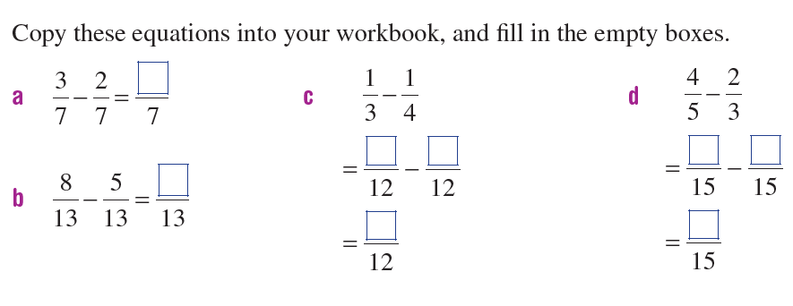
Practice Time!
On your left hand side

Slide 6
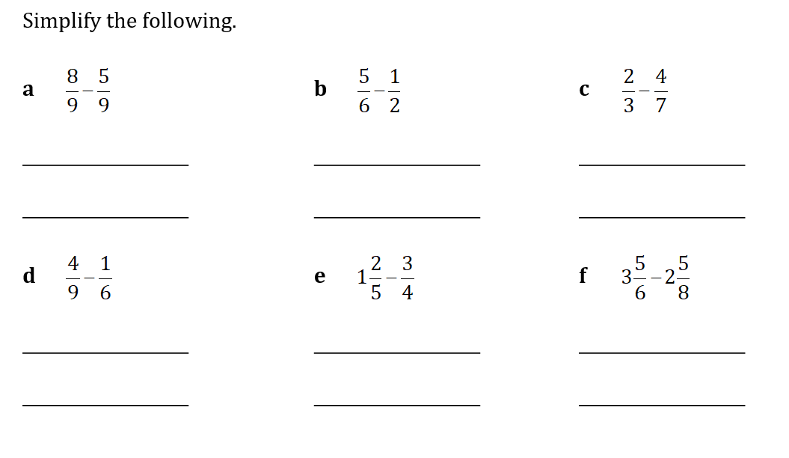

Slide 7
Summary
To subtract fractions we…….

